Slide 1
Optimizing Protein Titer Production
Predictive Modeling and Recommendations for Enhanced Yield
Jackson E. Polk
July 24th, 2023
Notes:
-Take your time
-Get the words right
-Anunciate

Slide 2

Project Definition
Recombinant Protein Production
Use “host” cells to inject with instructions to reproduce valuable proteins
Protein produced described by “titer”
Cytovance Biologics
Biomanufacturing company in Oklahoma City
Specializes in mammalian cell “hosts”
Chinese Hamster Ovaries (CHO)
Experimented on input variables and their effect on titer production
Seeking insight into optimal input variable combinations
Advised by Dr. Talayeh Razzaghi
Notes:
-Mammalian, Bacteria, Yeast, or Insect
-Mammalian cells take longer
-CHO is fascinating, but very common in recombinant protein production industry

Slide 3
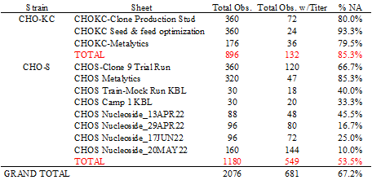
Data Ingestion
Cytovance experimental data
Given data via Microsoft Excel
11 “sheets” across 2 files
13 input variables
18 output variables
Issues with formatting
Merged cells
Special characters
“Separator” columns
Microsoft PowerQuery solution
Unmerge cells
Remove special characters
Append all data together
Raw Data Quality

Slide 4
Data Exploration

Slide 5
Data Exploration
Initial data treatment:
“N/A” in pH Setpoint, Temp, Dissolved Oxygen replaced with null
Input data observations:
Large magnitude differences
Small # unique values
Features with low variance
Inputs Data Quality Report
Notes:
Must format data first

Slide 6
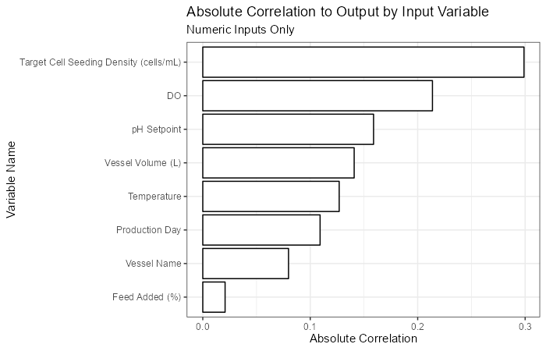
Data Exploration
From raw numeric data:
Target Cell Seeding Density has highest correlation to Titer amongst inputs
Feed Added (%) has lowest correlation
Notes:
Better look at most promising vars

Slide 7
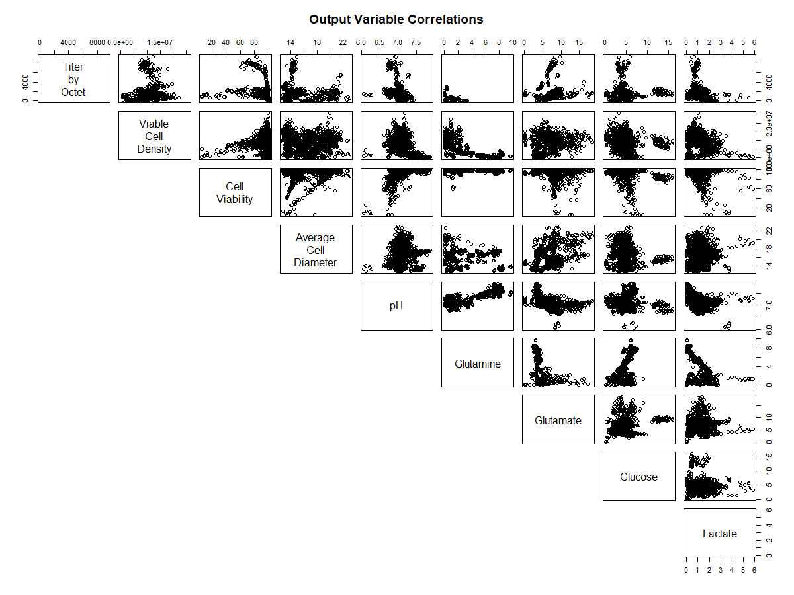
Data Exploration
Output variables have relationships with Titer
Glutamine
pH
Cell Viability
Osmolality
Potentially useful for imputation methods
MICE
Notes:
MICE has several methods it can use:
-Classification and Regression Trees
-LASSO
-Random Sample
-Random Forest Regression

Slide 8
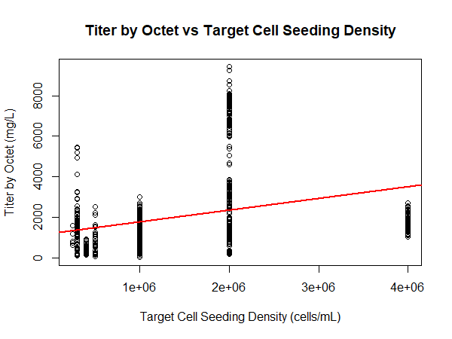
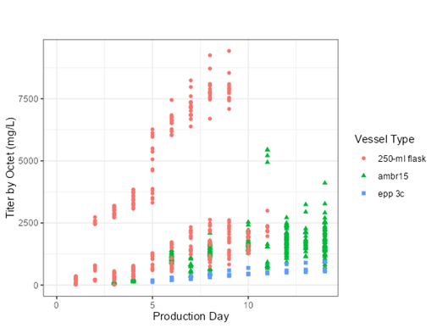
Data Exploration
Titer by Octet vs Production Day
Large amount of variability at two million cells/mL
Promising correlation, exposes vessel type as factor effect
Notes:
TCSD: many records held at this “2 million cells/mL” mark, explaining variability
PD: possible factor effect causing higher titer levels per liter at lower production days

Slide 9
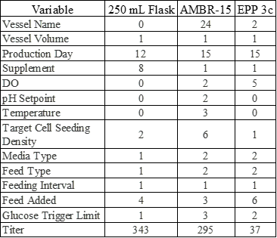
Data Exploration
Experiments with 250-mL flask differ
Lower number of variables changed
Will create a separate model for this subset of data
Time series
Unique Values by Vessel Type
Notes:
250-mL flask is only experimental run with supplement.
Only variables changed
-Production Day
-Supplement
-Target Cell Seeding Density
-Feed Added

Slide 10
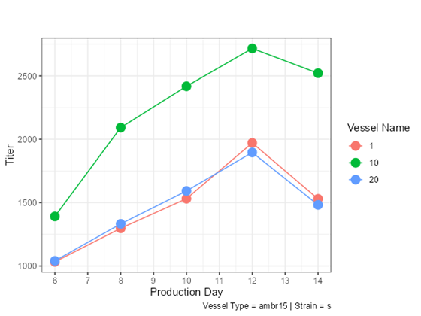
Data Exploration
Data is not missing at random.
Recording disturbs production
Example of Missing Data Behavior
Notes:
Time element and connectivity of observations opens door for time series imputation:
-Linear Interpolation
-Spline Interpolation

Slide 11
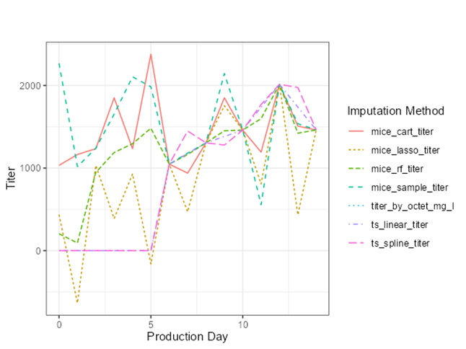
Data Preparation
Variety of imputation methods:
MICE
Classification and Regression Trees (CART)
LASSO
Random Forest
Random Sample
Time Series
Linear Interpolation
Spline Interpolation
Other steps:
Scaled numeric variables
“One-Hot” encoding
Example of Imputation Method Behavior
Notes:
Outliers were noted, but shared such a small portion of the data that they were not considered to have an impact on modeling.
Data mean-centered and scaled

Slide 12
Model Design

Slide 13
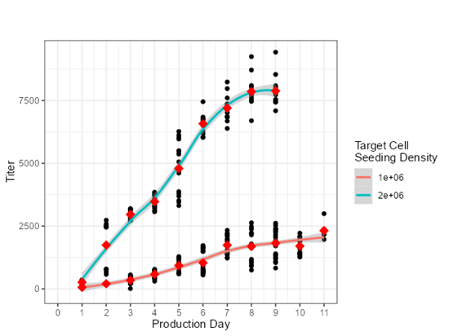
Model Design and Validation – Time Series
Model Selection
Process Validation
Time Series Interaction Effect
Target cell seeding density interaction effect
ARIMA modeling
Grid search P,Q, and D parameters
Known that time affects titer production.
Especially in mammalian cells [3]
Initial results welcomed by Cytovance
Explore ‘forecast RMSE’
Hold out final 3 days in series
Evaluate predictions for 3-day horizon

Slide 14
Model Design and Validation – Predictive Model
Model Selection
Process Validation
Split Train/Validate
Train Model
Test Model Tune
Split Test/Train
Train and tune a variety of models 20 times
Random Forest Regression
Gradient Boosted Trees
Multivariate Adaptive Regression Splines
Elastic Net
Linear Model
Evaluate each tune on the same test set
Various machine learning methods attempted previously [1][2]
Attempting to find which produces a significantly better RMSE
Initial results were welcomed by Cytovance
Repeat n =20 times
Notes:
Taper suggests less wasted time in production line

Slide 15
Predictive Modeling Flow Diagram
Imputation 1
Model 1
RMSE
Imputation 2
Model 2
RMSE
Raw Data
Pre-Process
…
…
Imputation n
Model m
RMSE
No imputation
Produce 20*(m*n) results
N=20
Notes:
20x(5 model types x 7 imputation methods) = 700 results total,
100 points per imputation method
140 points per model type

Slide 16
Results

Slide 17
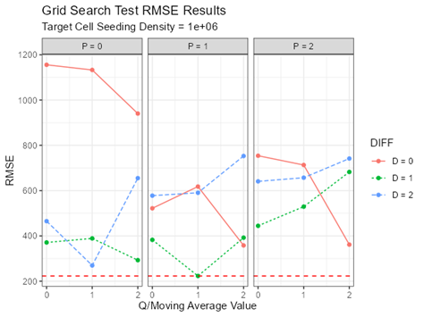
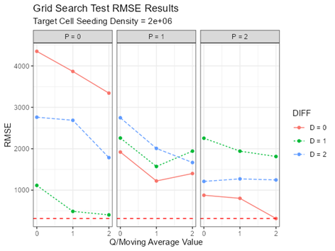
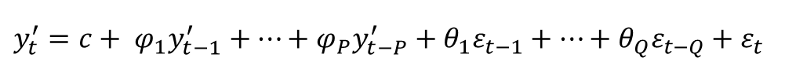
Model Results – Time Series
Trained on all but the final 3 production days.
Model tuned using grid search:
P = 0,1,2
Q = 0,1,2
D = 0,1,2
Final Model
2 Million Cells = (2,0,2)
1 Million Cells = (1,1,1)
ARIMA Model Grid Search
$$y_{t}^{′}=c+ φ_{1}y_{t−1}^{′}+…+φ_{P}y_{t−P}^{′}+θ_{1}ε_{t−1}+…+θ_{Q}ε_{t−Q}+ε_{t}$$
Notes:
Focus on how resulting parameter values can be interpreted

Slide 18
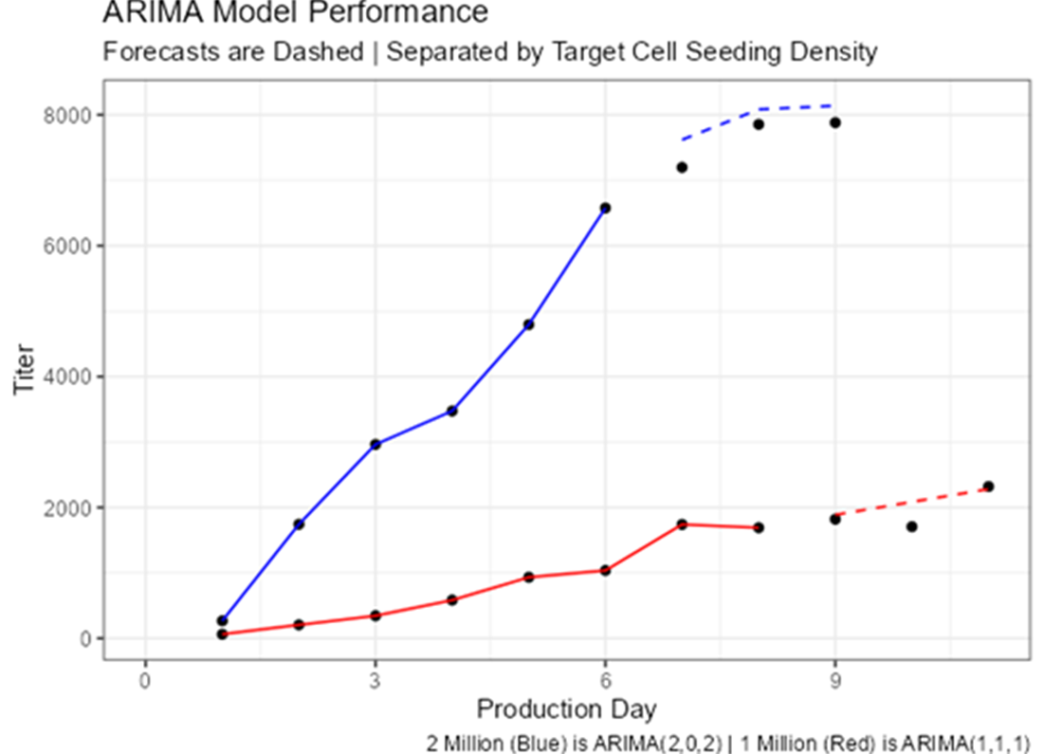
Evaluation – Time Series
Relatively low RMSE
1 Million Cells = 223.19
2 Million Cells = 314.61
Taper in production accurately captured
Notes:
Autoregressive and moving average terms helped the 2 million cell time series capture the taper after 8 days.

Slide 19
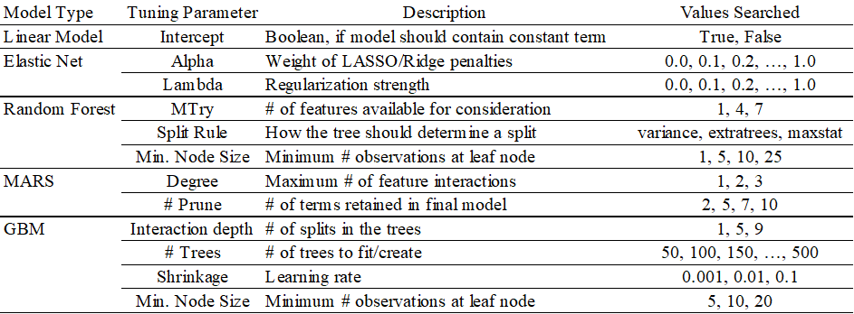
Model Results – Predictive Modeling
Trained using 80% of the data
Train each model to predict various versions of titer
Imputed and non-imputed
5-fold cross validation, 2 repeats
Process repeated 20 times
Hyperparameters tuned using Grid Search
Hyperparameters Considered

Slide 20
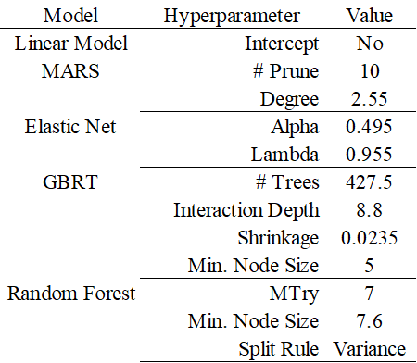
Model Results – Predictive Modeling
Hyperparameters tuned with Grid Search
Hyperparameters expose how data interpreted by algorithm
Grid Search Average/Most Frequent Results

Slide 21
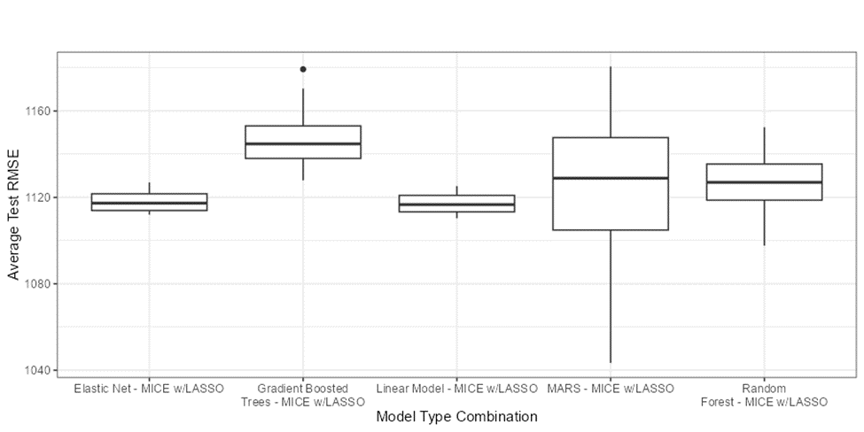
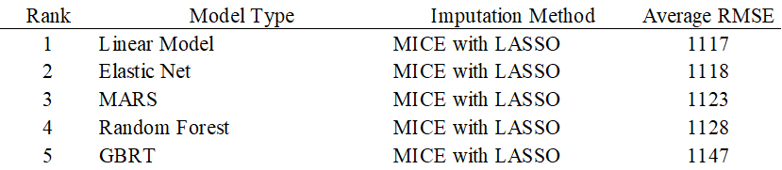
Model Results – Predictive Modeling
Each model evaluated using RMSE
Average RMSE similar
Best models compared using Tukey Comparison of Means
GBRT was determined to be less powerful
Other models are “interchangeable”
Best Model Tune Performance Comparison
Notes:
The model types are only interchangeable because of the low input data quality. With more data its possible there would be better results, but almost 70% of the outcome variable is an approximation.

Slide 22
Model Results – Variable Importance
Utilize “Variable Importance” from each model to rank features.
Aggregate average rank
Analyze interactions amongst the top 5
Variable Importance Aggregation

Slide 23
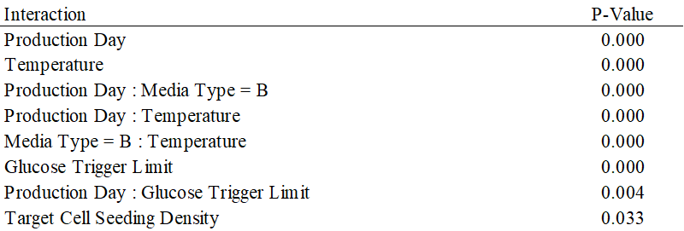
ANOVA on Important Features
Analysis of Variance (ANOVA) vital to completing business objective
Important Features and Interactions
Notes:
Extended analysis suggests that for shorter production

Slide 24
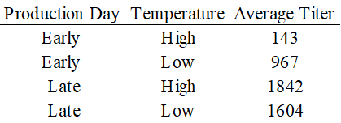
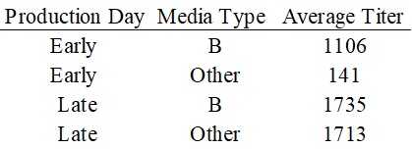
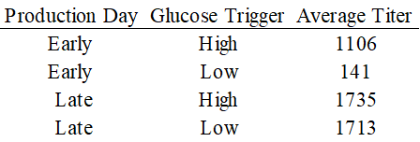
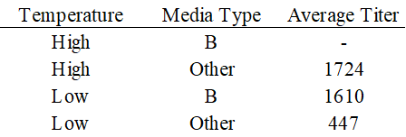
Feature Interactions
Determined using factorial design analysis:
Shorter production runs should use:
Higher glucose trigger limit
Media type B
Low temperature
Longer production runs should consider temperature shifts in later days

Slide 25
Conclusion
Identified a variety of modeling methods suitable for titer prediction
Identified important features and relationships among them
Cytovance benefits
Guidelines for titer production inputs
Optimal inputs change with time
Recommendations for Improvement
Train more non-linear models
Combine 250-mL flask and other vessel types into single model
Gather more data
Attempt input value imputation
Notes:
This project also attempted to recover several missing observations of titer, which was a significant issue in the final model performance.

Slide 26
References
[1] Puranik, A, Dandekar, P, Jain, R. Exploring the potential of machine learning for more efficient development and production of biopharmaceuticals. Biotechnol. Prog. 2022; 38( 6):e3291. doi:10.1002/btpr.3291
[2] Ian Walsh, Matthew Myint, Terry Nguyen-Khuong, Ying Swan Ho, Say Kong Ng & Meiyappan Lakshmanan (2022) Harnessing the potential of machine learning for advancing “Quality by Design” in biomanufacturing, mAbs, 14:1, DOI: 10.1080/19420862.2021.2013593
[3] Recombinant Protein Production. (2021, December 16). City Tech CUNY. https://bio.libretexts.org/@go/page/75276

